Slide 1
Analysis of crime against women in India
By : Meenal Shree

Slide 2
Description
The aim of my project is to analyze the data of crimes that are done against the women in India during the period 2001-2012.
I am trying to find the major crimes that are done against the women in each state,

Slide 3
Objective
Analyse the crimes done against women in India between 2001 to 2012.
Tried to find the percentage increased between years .
Partition the table based on crimes.
Filter the data based to find the major crime against women per state.
Total average change in crimes between 2001 and 2012.
Exported specific queries into HDFS.
Imported the results into MySQL using SQOOP.

Slide 4
Technologies Used
HIVE
HDFS
SQOOP
MySQL

Slide 5
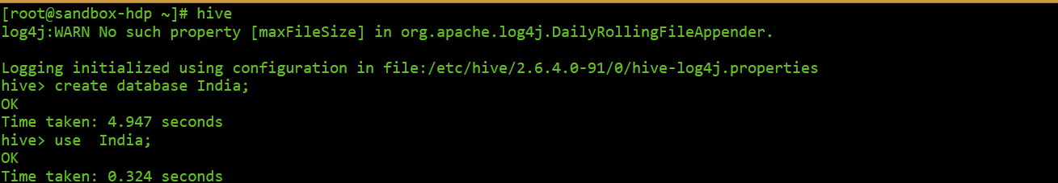
Creating database
create database india;
use india;

Slide 6
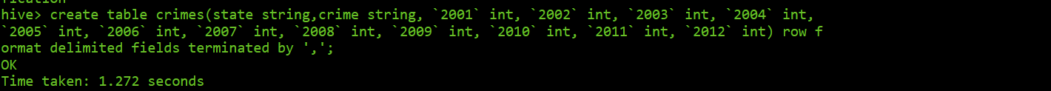
Creating Table
create table crimes(state string, crime string, `2001` int, `2002` int, `2003` int, `2004` int, `2005` int, `2006` int, `2007` int, `2008` int, `2009` int, `2010` int, `2011` int, `2012` int) row format delimited fields terminated by ‘,’;
Here we are creating a table with required columns . The input consist of the field separated by the ’ ,’ so i set the delimiter as ‘,’

Slide 7
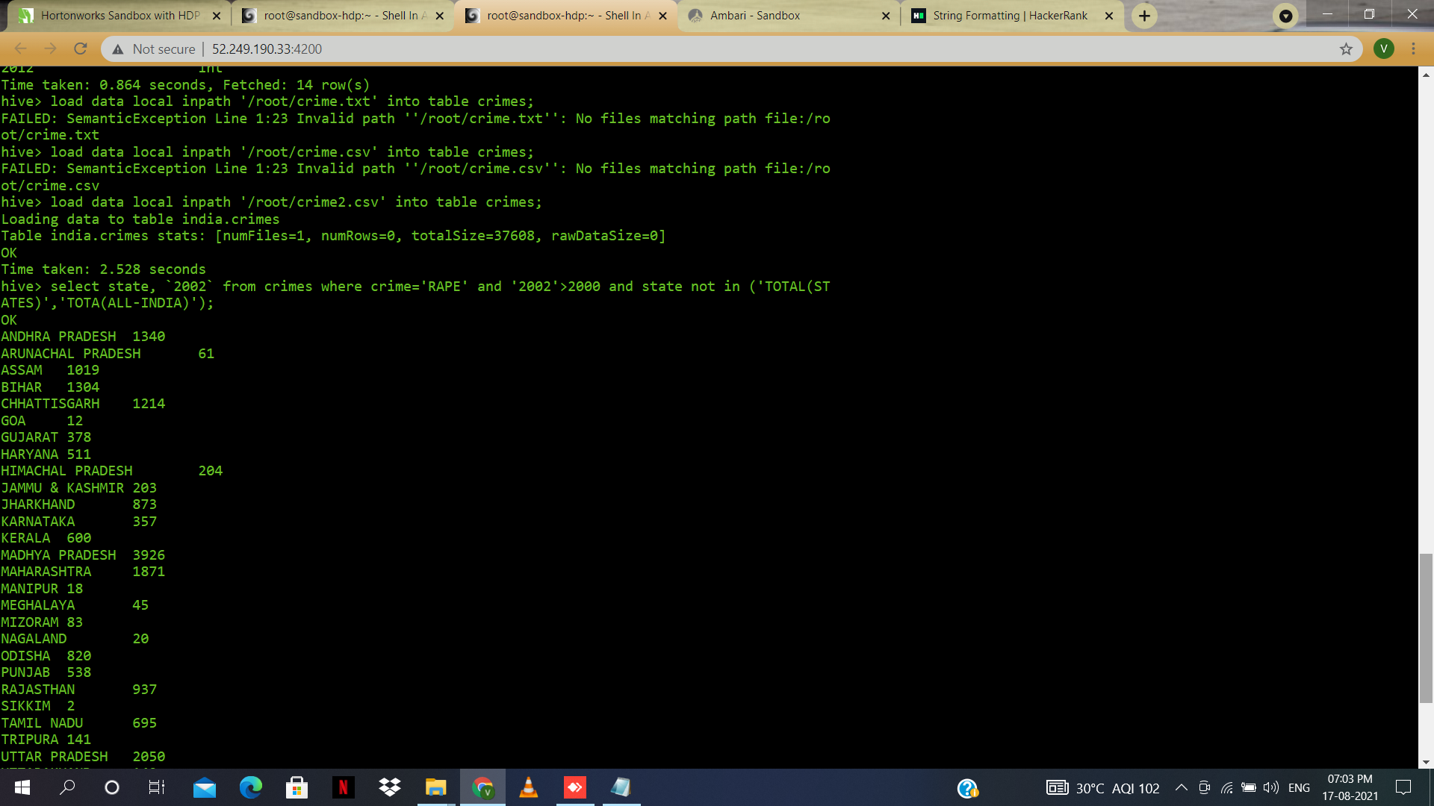
Loading tha data into HIVE table
load data local inpath '/root/crime.txt' into table crimes;
Loading the data from the local storage into the hive table

Slide 8
Filtering the output based on crime (Rape)
select state,`2002` from crimes where crime='RAPE' and `2002`>2000 and state not in ('TOTAL (STATES)','TOTAL (ALL-INDIA)’);
Displaying the rape cases in 2002 where cases are greater than 2000,the output will show the states followed by the number of rape cases.Here we are not including the total values.

Slide 9
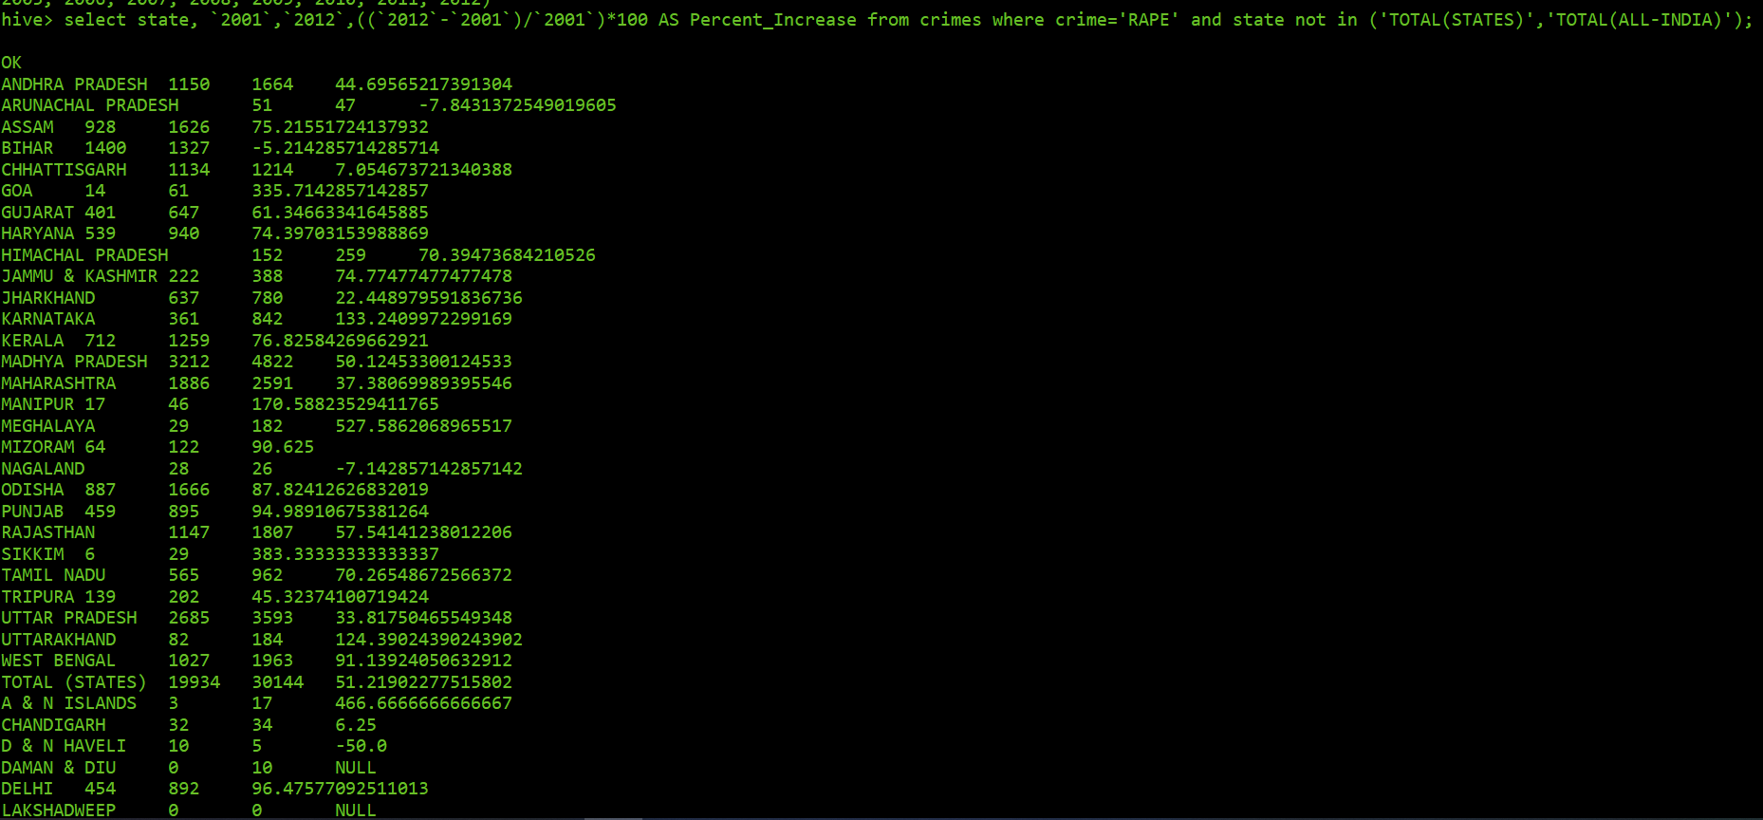
Determining average change between any two years
select state,`2001`,`2012`,((`2012`-`2001`)/`2001`)*100 AS Percent_Increase from crimes where crime='RAPE' and state not in ('TOTAL (STATES)','TOTAL (ALL-INDIA)’) ;
Displaying the percentage increase of crime(Rape) in each state by comparing the data from 2001 and 2012

Slide 10
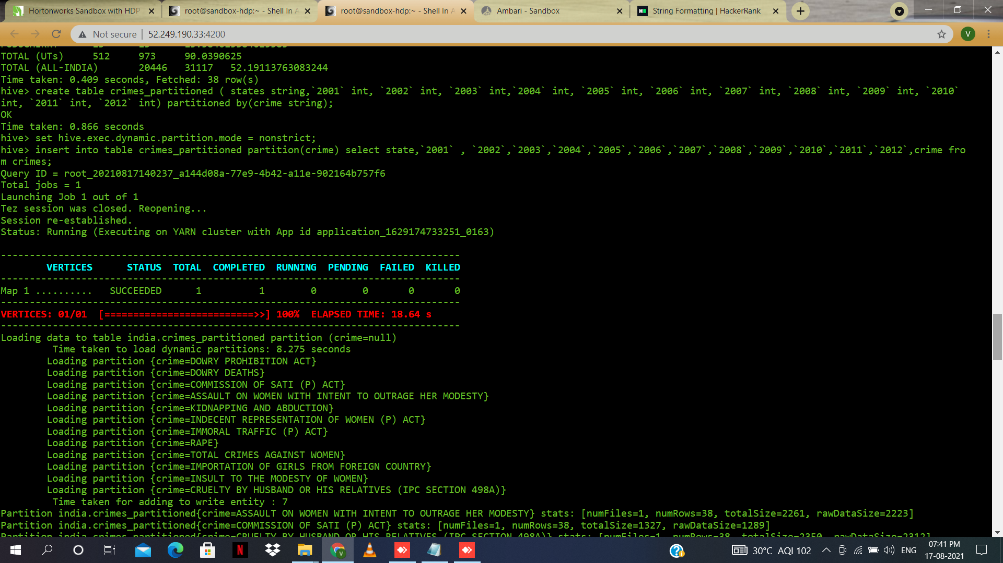
Creating partition table
create table crimes_partitioned(state string, `2001` int, `2002` int, `2003` int, `2004` int, `2005` int, `2006` int, `2007` int, `2008` int, `2009` int, `2010` i nt, `2011` int, `2012` int) partitioned by (crime string);
Created partition table with name(crimes_partitioned) for the crimes table based on the crime column

Slide 11
Enabling dynamic partition
set hive.exec.dynamic.partition.mode=nonstrict;
Enabling the dynamic partitioning in HIVE so that it can automatically create the partitions based on the unique values of the column

Slide 12
Inserting data into partition table
insert into table crimes_partitioned partition (crime) select state ,`2001` ,`2002` ,`2003` ,`2004` ,`2005`,`2006`,`2007`,`2008`,`2009`,`2010`,`2011`,`2012`,crime from crimes;
Inserting the data from crimes table into the crimes_partitioned table partitioned by the crime column in the crimes table

Slide 13
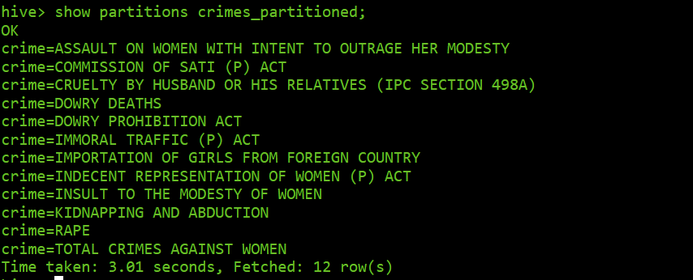
Displaying the partitions of the partition table
show partitions crimes_partitioned;
Displaying the partitions of the crimes_partitioned table.

Slide 14
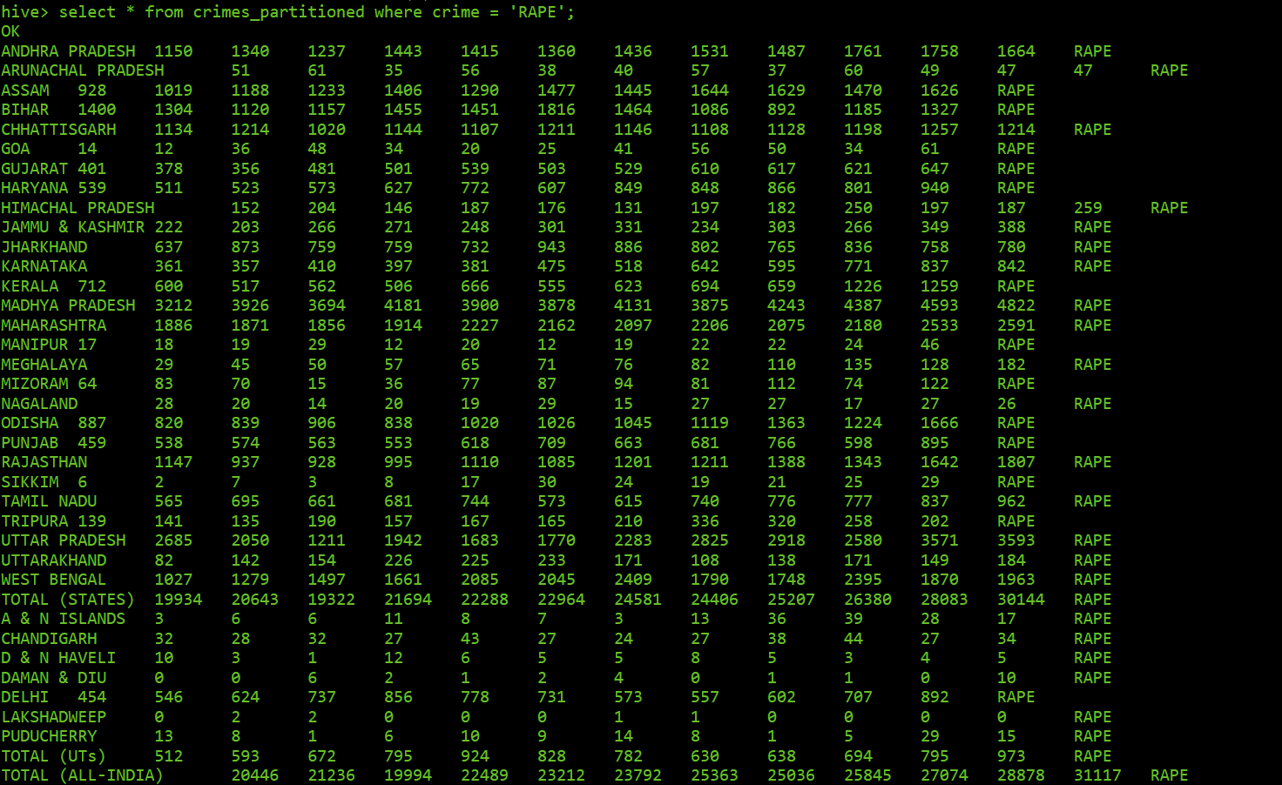
Selecting data from partition
select * from crimes_partitioned where crime='RAPE’;
Selecting data from the partition “crime = RAPE” which is stored in the HIVE directory in HDFS.

Slide 15
Finding the total average change in crimes
select state,((((`2002`-`2001`)/`2001`)+((`2003`-`2002`)/`2002`)+((`2004`-`2003`)/`2003`)+((`2005`-`2004`)/`2004`)+((`2006`-`2005`)/`2005`)+((`2007`-`2006`)/`2006 `)+((`2008`-`2007`)/`2007`)+((`2009`-`2008`)/`2008`)+((`2010`-`2009`)/`2009`)+((`2011`-`2010`)/`2010`)+((`2012`-`2011`)/`2011`))*100)/12 as Avg_Increase from crimes where crime = 'TOTAL CRIMES AGAINST WOMEN' order by Avg_Increase desc;
Finding the total average change in the crimes against women over the period of 2001 to 2012 based on the Total Crimes done against women in each year.

Slide 16
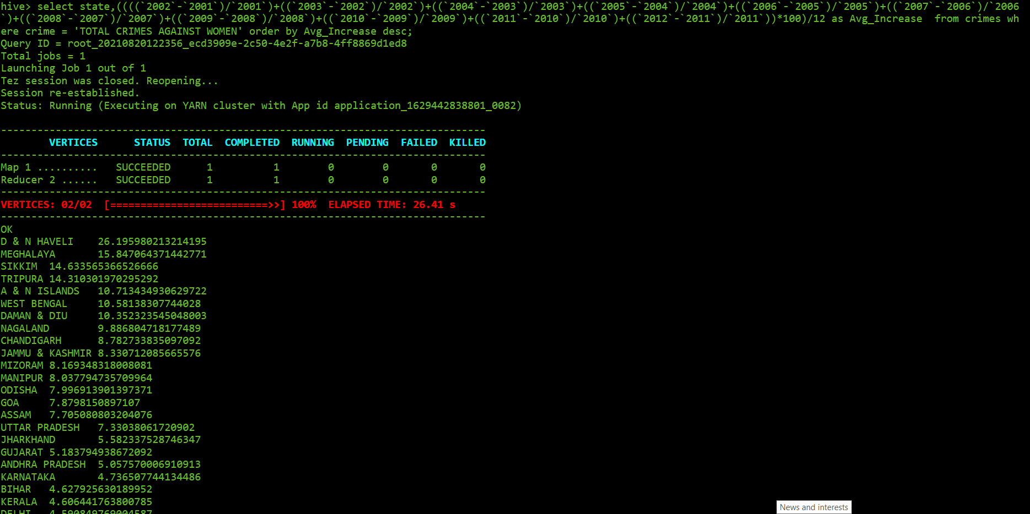
Finding the total average change in crimes
(screen shot)

Slide 17
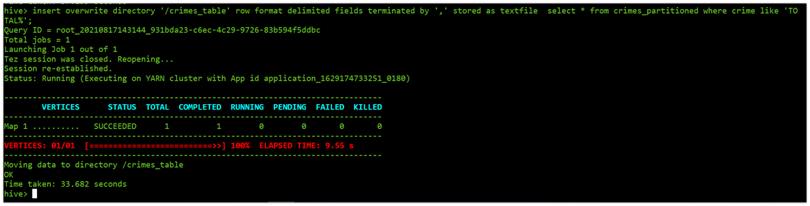
Exporting query result to HDFS
insert overwrite directory ‘/crimes_table’ row format delimited fields terminated by ’,’ stored as textfile select * from crimes_partitioned where crime like ‘TOTAL%’;
Exporting the result of the select query into the HDFS which is delimited by ‘,’ and stored as a text file.

Slide 18
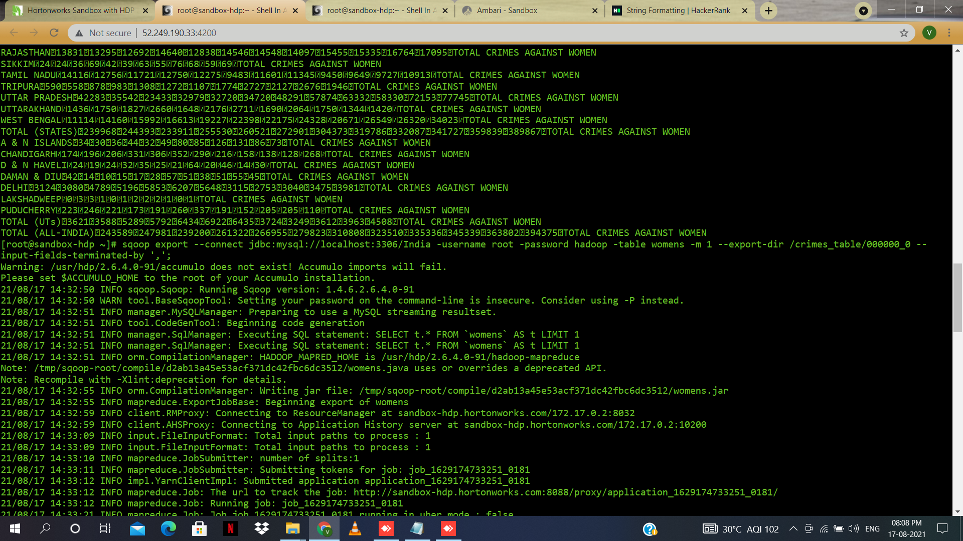
Importing the result into MySQL
sqoop import –connect jdbc:mysql://localhost:3306/India -username root –password hadoop –table womens –m 1 –export-dir /crimes_table/000000_0 –input-fields-terminated-by ‘,’;
Importing the query result from HIVE into MySQL using SQOOP . Here womens is the table name in MySQL and the output from HIVE is saved in the file 000000_0 which is the textfile with field separated by ‘,’

Slide 19
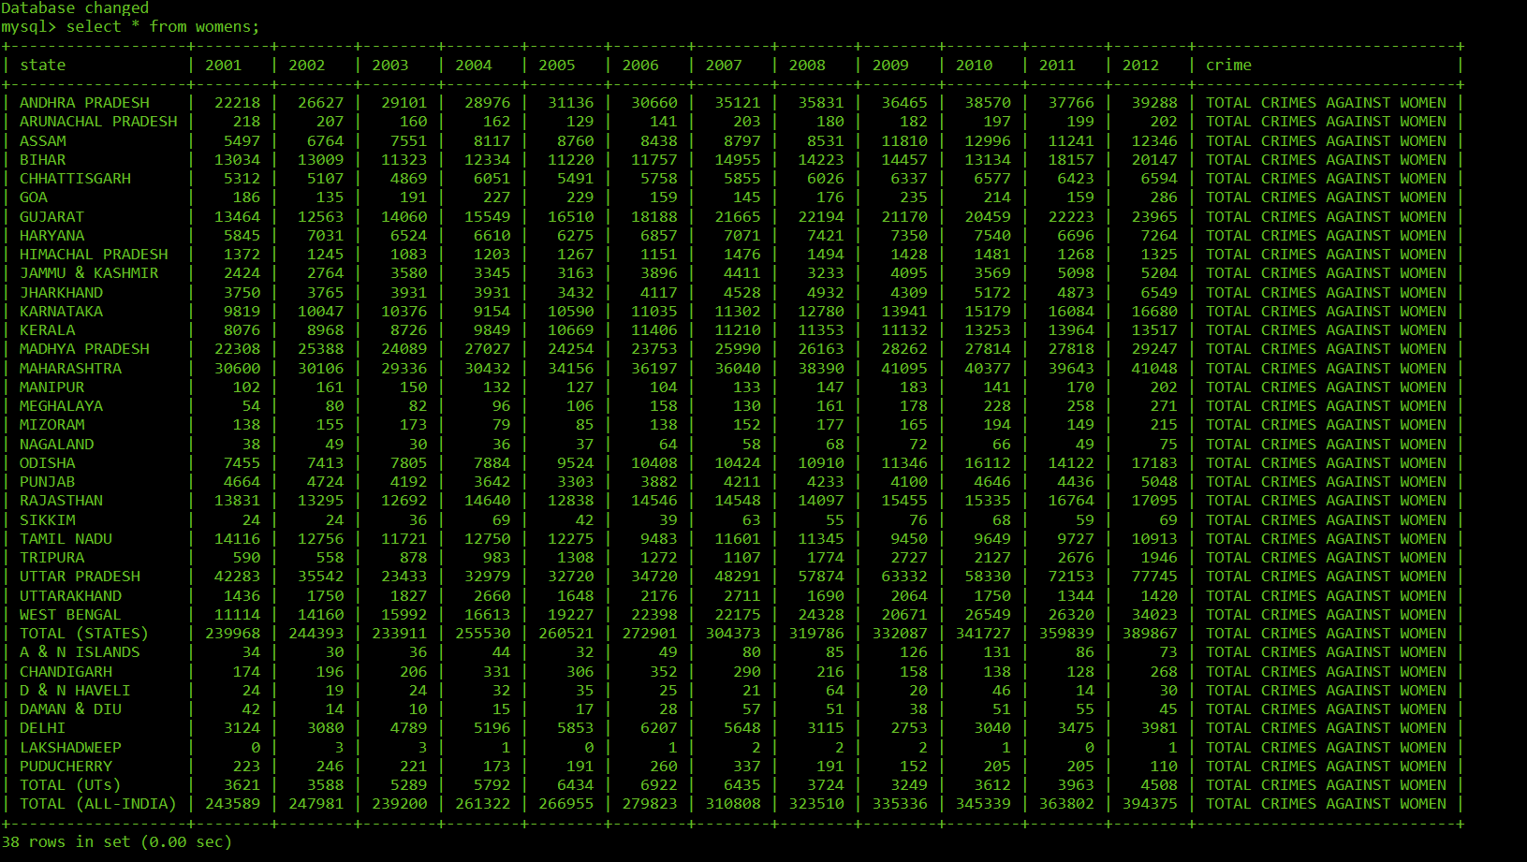
Import data in MySQL
select * from womens;
Displaying the query result in MySQL

Slide 20
Conclusion
Total crimes against women is increasing every year where Uttar Pradesh is having the highest number of cases between year 2001 to 2012.
Puducherry and Tamil Nadu saw a decrease in the crimes against women during this time period.
The major crime against women is “cruelty by husband or his relatives (IPC section – 498A) during this time period.
Lakshadweep was having the lowest number of cases having maximum of three cases of total crimes against women that was in year 2002 and 2003.

